Slide 1



Slide 2

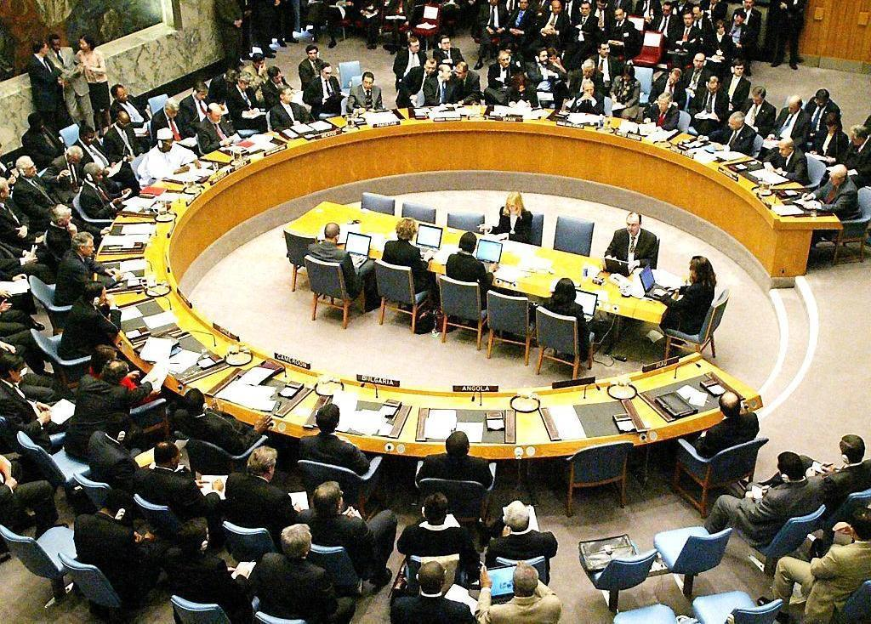
Spot the ‘world deteriorator’

Slide 3

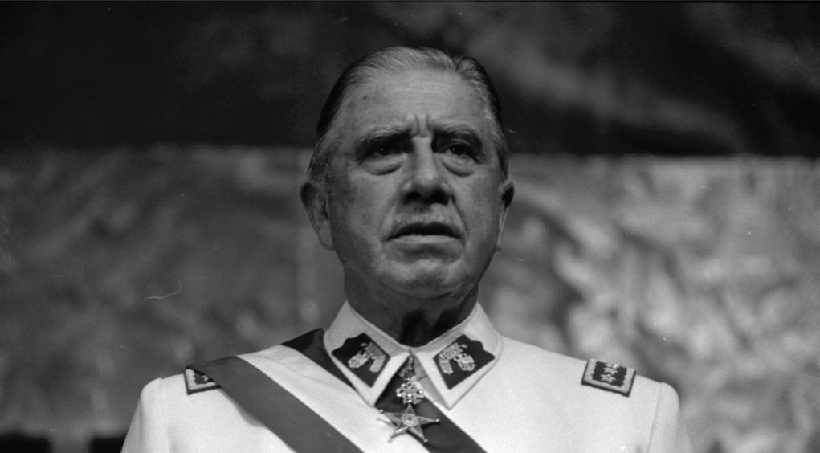
QUESTION 1
Who is this?

Slide 4
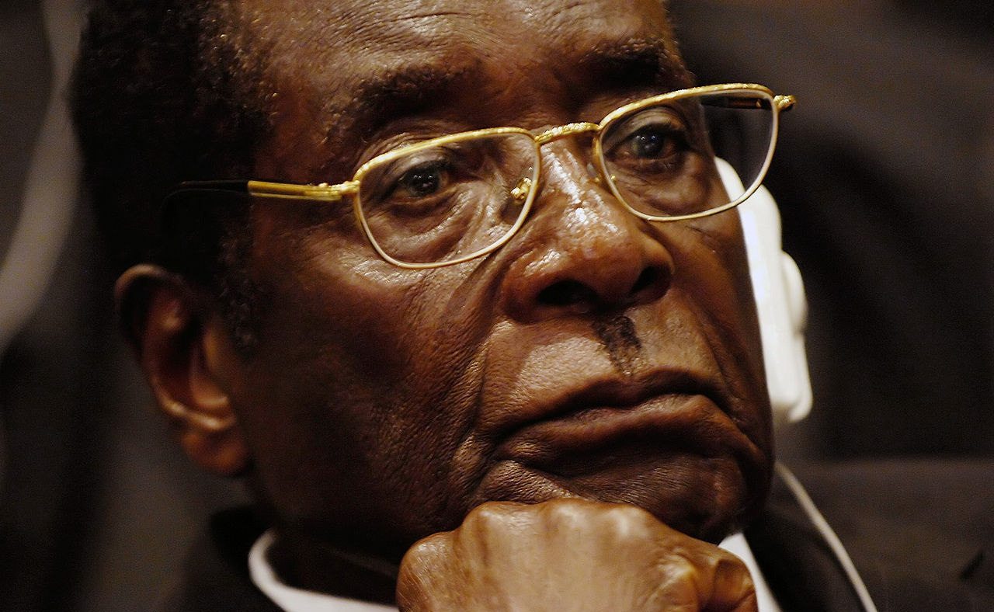
QUESTION 2
Who is this?

Slide 5
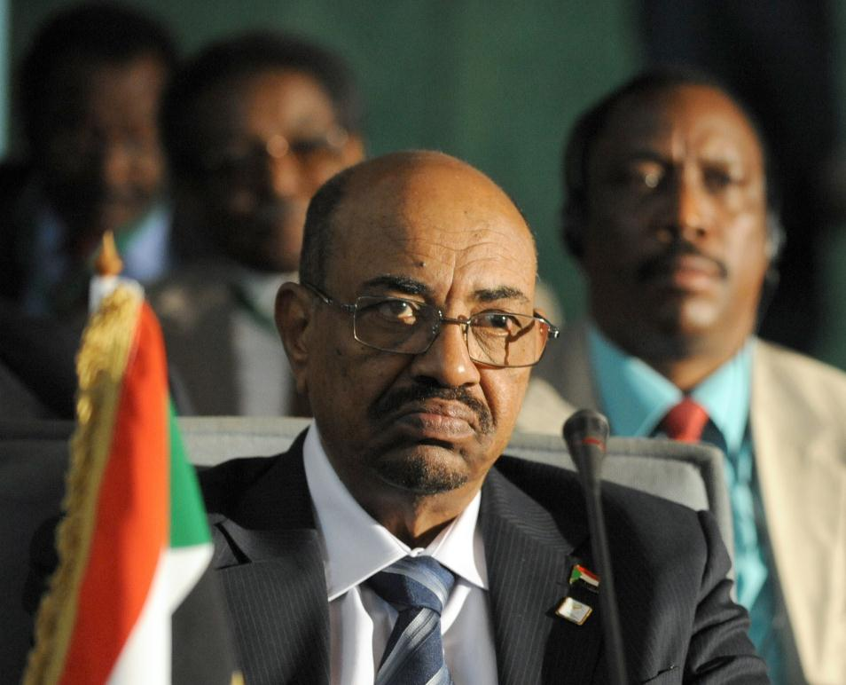
QUESTION 3
Who is this?

Slide 6
Soundbites

Slide 7

QUESTION 1
Who is this?

Slide 8
Principles

Slide 9
QUESTION 1
In what year was the Universal Declaration of Human Rights (UDHR) adopted by the United Nations?
Notes:
*

Slide 10
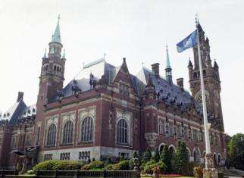
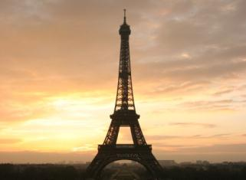
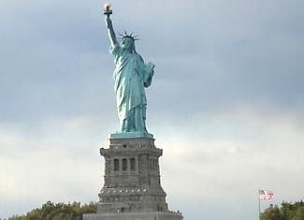
QUESTION 2
Where (in which city) was the Universal Declaration of Human Rights adopted?
a.
The Hague
b.
Paris
c.
New York
Notes:
*

Slide 11
QUESTION 3
Article 19 is about freedom of expression and information. Why are these two inextricably linked?
a. You need information to forge an opinion.
b. You may say whatever you want but also communicate any message.
c. You always have to express information that is correct.
Notes:
*

Slide 12
QUESTION 4
Nearly all countries have ratified the UN Convention on the Rights of the Child. Which three countries haven’t?
a. North Korea, Nigeria and Cuba
b. China, the United States and Russia
c. Somalia, South Sudan and the United States
Notes:
*

Slide 13
Film

Slide 14
QUESTION 1
In what movie Meryl Streep has to choose which of her two children will continue to live?
a. The Chosen
b. Sophie´s Choice
c. Choose me
Notes:
*

Slide 15

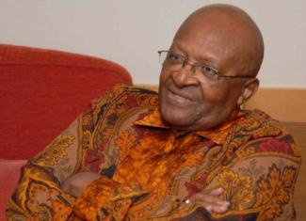
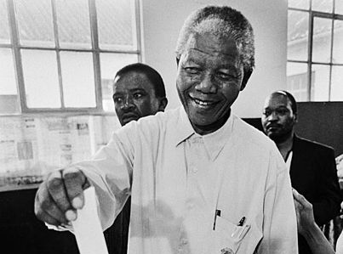
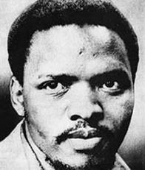
QUESTION 2
Which anti-apartheid activist is featured in the movie
‘Cry Freedom’ (1987)?
a.
Nelson Mandela
b.
Steve Biko
c.
Desmond Tutu
Notes:
*

Slide 16
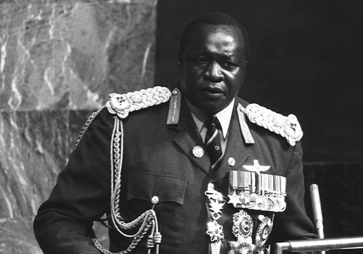
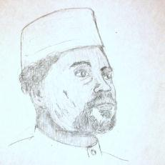
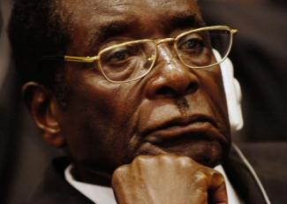
QUESTION 3
What African dictator is featured in
the film ‘The Last King of Scotland’?
a.
Idi Amin
b.
Hissène Habré
c.
Robert Mugabe
Notes:
*

Slide 17
QUESTION 4
‘Argo’ is a 2012 American thriller about the liberation by a CIA agent of six American diplomats who had been taken hostage in Tehran on 4 November 1979, after the Shah’s forced abdication. How many days lasted the hostage-taking?
a. 66 days
b. 222 days
c. 444 days
Notes:
*

Slide 18
General

Slide 19
QUESTION 1
What is meant by ‘human rights defenders’?
a. Everyone who in any way protects human rights.
b. Professionals, such as lawyers, journalists and paid
employees of human rights organizations.
c. People working for human rights organizations.
Notes:
*

Slide 20
QUESTION 2
What can not be considered a human right?
a. The right to peace.
b. The right to rest and leisure.
c. The right to leave one’s country and return.
Notes:
*

Slide 21
Looking back

Slide 22
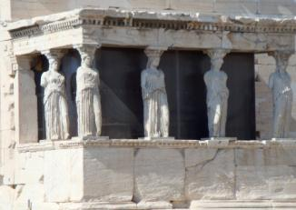
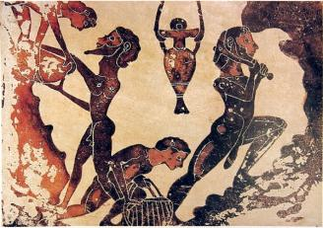
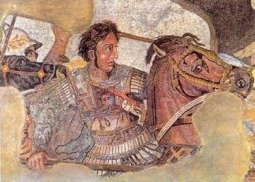
QUESTION 1
Ancient Athens already had a form of democracy. Who had voting rights?
a.
Women
b.
Slaves
c.
Foreigners
Notes:
*

Slide 23



QUESTION 2
Which of these famous statements came first?
a.
The Declaration of the Rights of the Citizen
b.
The Declaration of Independence
c.
The Declaration on the Abolition of Slavery
Notes:
*

Slide 24


QUESTION 3
Slavery was first abolished in:
a.
Haiti
b.
The Netherlands
c.
The United States
Notes:
*

Slide 25
QUESTION 4
The Netherlands have a national human rights institute since October 2012. What is its name?
a. The Netherlands Institute for Human Rights
b. The Max van der Stoel Institute
c. The Equal Treatment Commission
Notes:
*

Slide 26
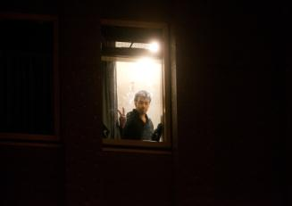
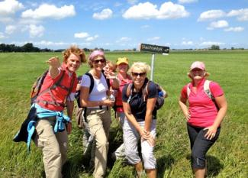

QUESTION 5
The Netherlands ratified many international treaties, yet not the Convention on the protection of the rights of:
a.
Migrants
b.
Women
c.
Children
Notes:
*

Slide 27

QUESTION 5
The Netherlands is an arms exporting nation. What is its international ranking in this respect?
a.
3
b.
10
c.
21
Notes:
*

Slide 28
Facts from around the world

Slide 29
QUESTION 1
Who said in March 2012: ‘I’d rather be a dictator than gay’?
a. Vladimir Putin, president of the Russian Federation.
b. Alexander Lukashenko, president of Belarus.
c. Viktor Yanukovich, then president of Ukraine.
Notes:
*

Slide 30
QUESTION 2
Homosexuality is banned by law in many countries. How many?
25
75
150
a.
About 25 countries
b.
About 75
countries
c.
No less than 50 countries
Notes:
*

Slide 31
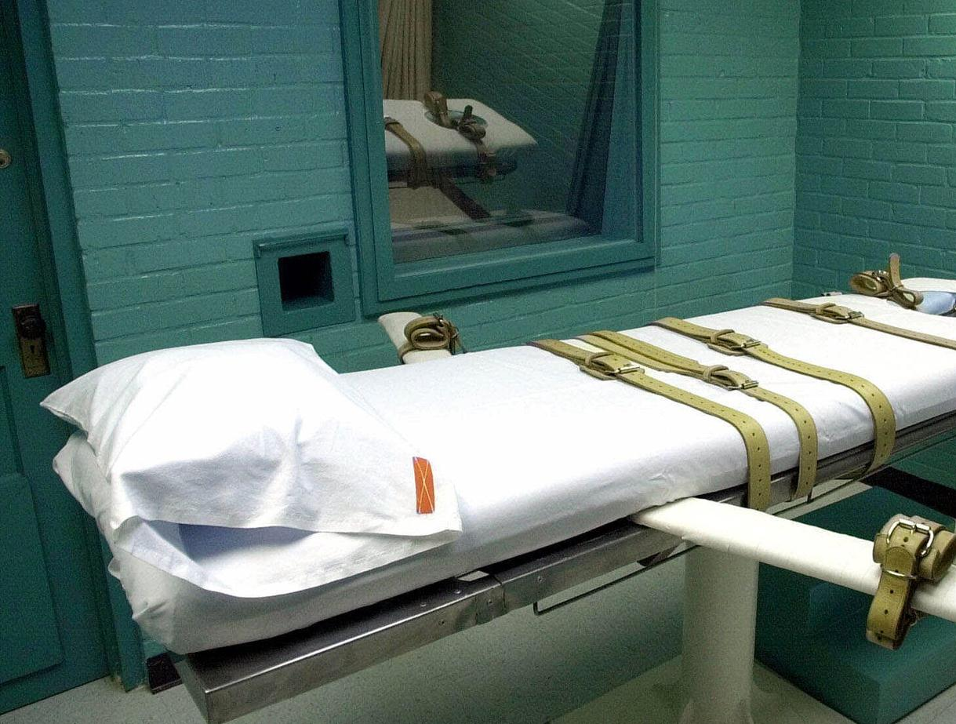
QUESTION 3
In how many European countries capital punishment is still applied?
a. 10 countries.
b. 1 country.
c. Nowhere.

Slide 32
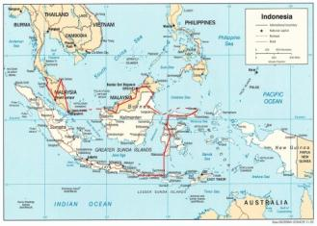
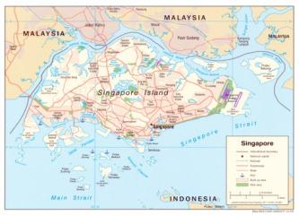
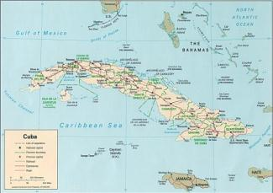
QUESTION 4
What country has the highest execution rate, considering the size of its population?
a.
Indonesia
b.
Singapore
c.
Cuba
Notes:
*

Slide 33
QUESTION 5
What military dictatorship most recently won the World Cup?
a. Brazil at the time of the military junta.
b. Argentina at the time of president Videla.
c. Chile at the time of president Pinochet.
Notes:
*

Slide 34
Human rights awards

Slide 35

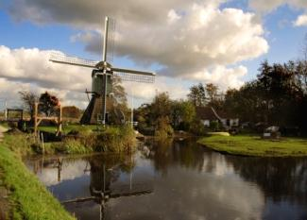
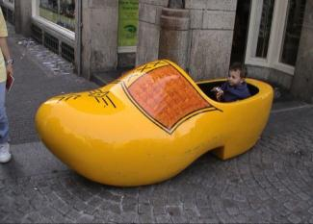
QUESTION 1
What human rights prize is awarded by the Dutch Ministry of Foreign Affairs?
a.
Human Rights
Tulip
b.
Human Rights Mill
c.
Human Rights
Wooden Shoe
Notes:
*

Slide 36
QUESTION 2
In 2010, Chinese author Liu Xiaobo won the Nobel Peace Prize.
However, he did not attend the award ceremony. Why not?
a. He fell ill in captivity and was unable to travel.
b. He was imprisoned at the time.
c. He was allowed to leave China, but was afraid he would
not be allowed to return.
Notes:
*

Slide 37
Spot the do-gooder

Slide 38
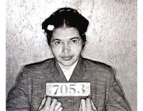
QUESTION 1
Who is this?

Slide 39
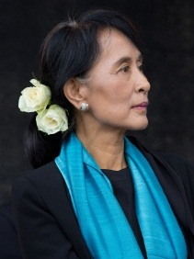
QUESTION 2
Who is this?

Slide 40
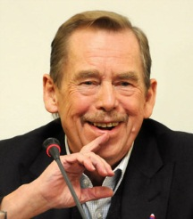
QUESTION 3
Who is this?

Slide 41
Put the photos in chronological order

Slide 42
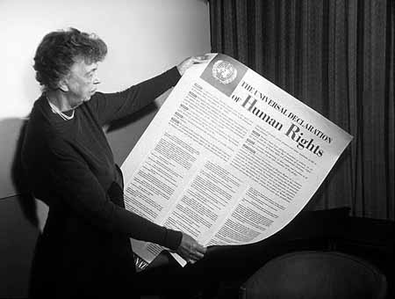
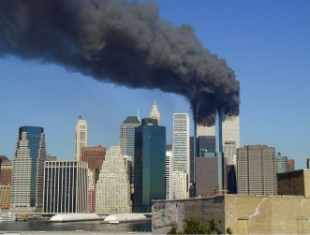
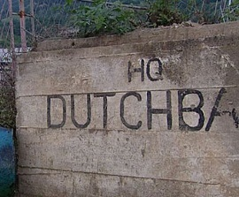
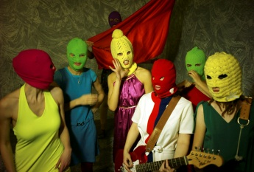
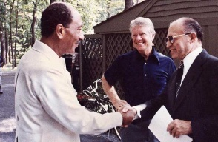
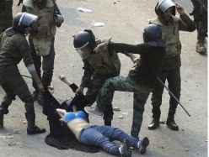
a.
c.
e.
d.
b.
f.

Slide 43

COLOFON
An initiative of
© 2013

